Slide 1
JavaScript and Frameworks. Velocity, JQuery. AJAX
By: Tsiupak Olena

Slide 2
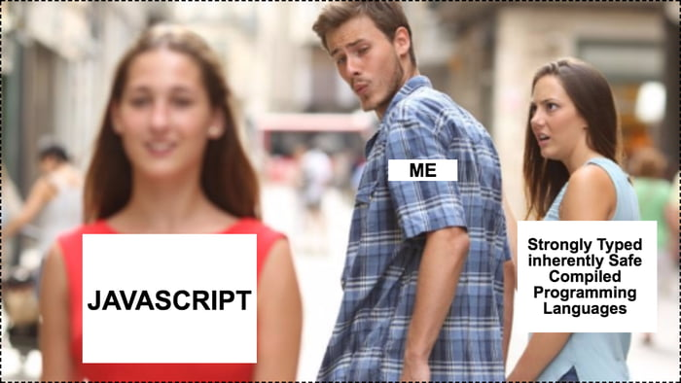
About JavaScript
JavaScript is a programming language that is characterized as dynamic, weakly typed and multi-paradigm.
As a multi-paradigm language, JavaScript supports event-driven, functional, and imperative (including object-oriented and prototype-based) programming styles. It has APIs for working with text, arrays, dates, regular expressions, and the DOM.

Slide 3

About JavaScript typing
JavaScript uses dynamic, duck typing.
Duck typing is an application of the duck test—"If it walks like a duck and it quacks like a duck, then it must be a duck"—to determine if an object can be used for a particular purpose. With normal typing, suitability is determined by an object's type. In duck typing, an object's suitability is determined by the presence of certain methods and properties, rather than the type of the object itself.

Slide 4
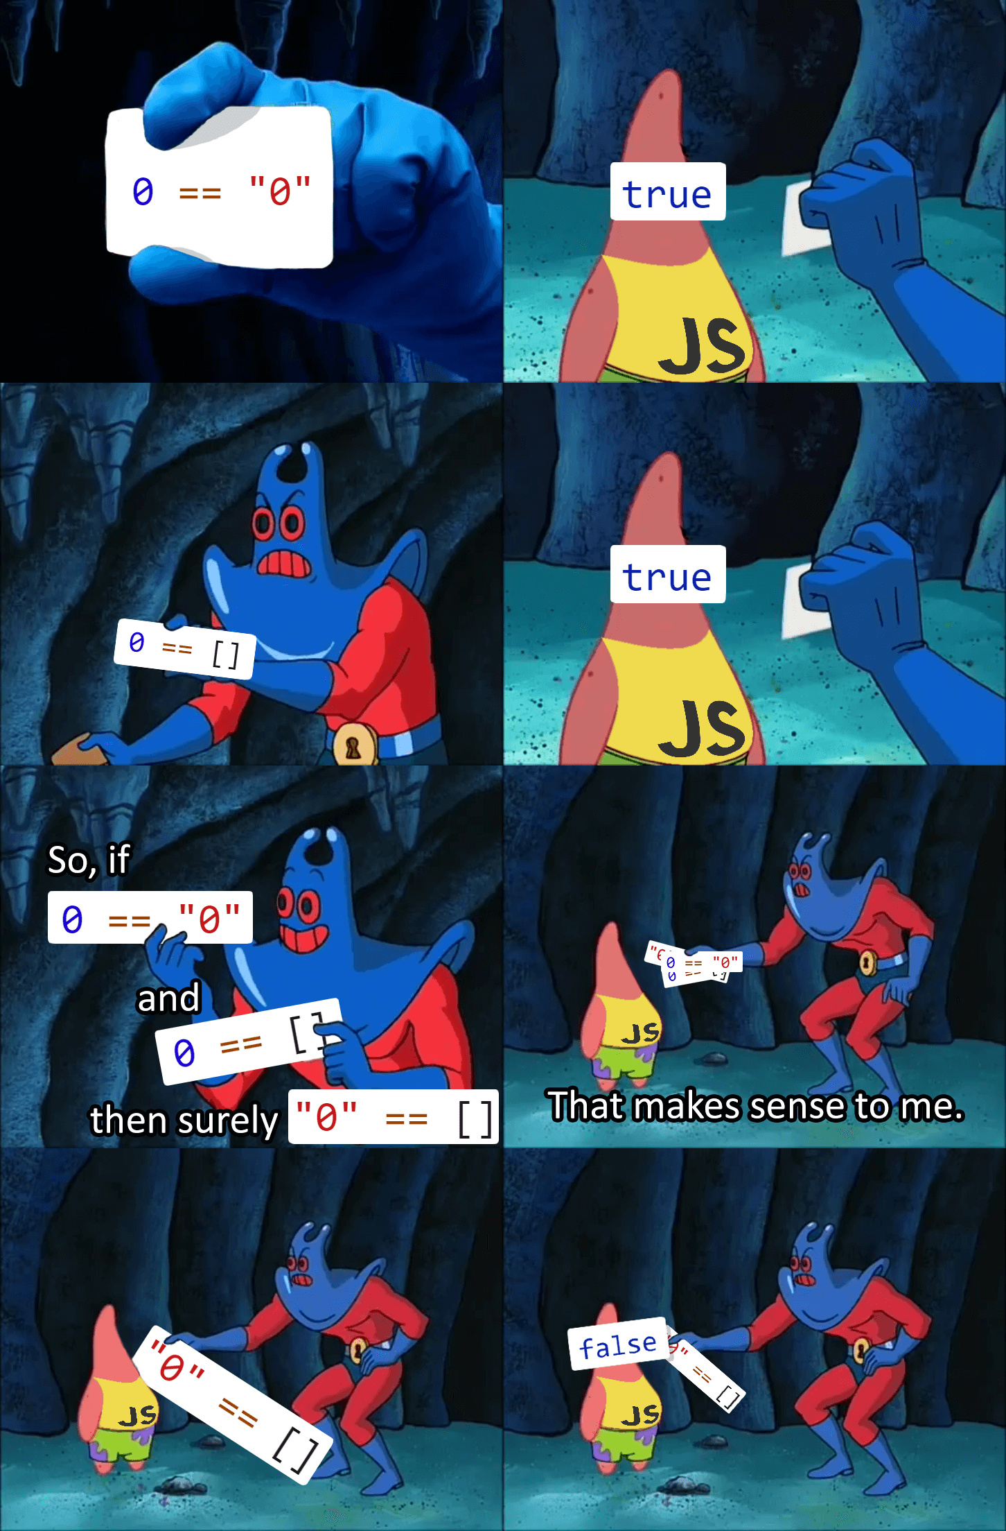
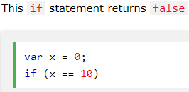
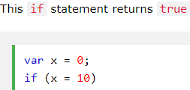
JavaScript common mistakes
1. Accidentally Using the Assignment Operator
JavaScript programs may generate unexpected results if a programmer accidentally uses an assignment operator (=), instead of a comparison operator (==) in an if statement.

Slide 5
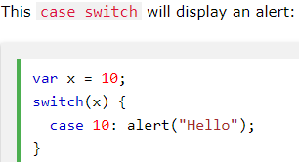
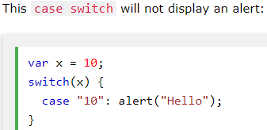
2. Expecting Loose Comparison
It is a common mistake to forget that switch statements use strict comparison:

Slide 6
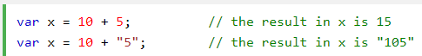
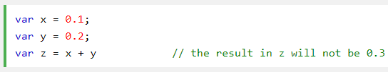
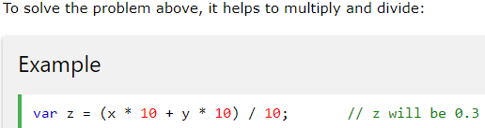
3. Confusing Addition & Concatenation
4. Misunderstanding Floats

Slide 7
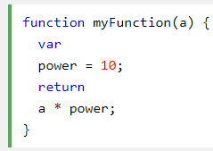
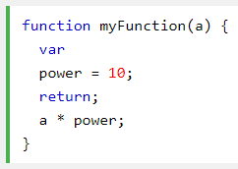
5. Breaking a Return Statement
It is a default JavaScript behavior to close a statement automatically at the end of a line.
The function will return undefined!
Why? Because JavaScript thought
you meant:

Slide 8
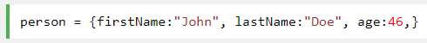
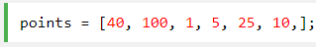
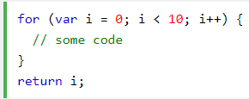
6. Ending Definitions with a Comma
IE 8 will crash
7. Expecting Block Level Scope
JavaScript does not create a new scope for each code block. It is true in many programming languages, but not true in JavaScript. This code will display the value of i (10), even OUTSIDE the for loop block:

Slide 9
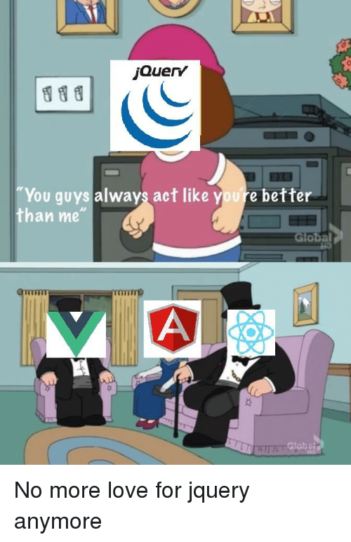
jQuery
jQuery is a lightweight, "write less, do more” JavaScript library designed to simplify HTML DOM tree traversal and manipulation, as well as event handling, CSS animation, and Ajax. Web analysis (from 2017) indicates that it is the most widely deployed JavaScript library by a large margin.

Slide 10
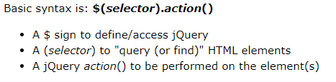
JQuery syntax
The jQuery syntax is made for selecting HTML elements and performing some action on the element(s).

Slide 11
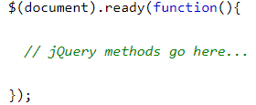
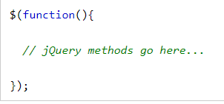
Tip: $(document).ready(…);
This is to prevent any jQuery code from running before the document is finished loading (is ready). It is good practice to wait for the document to be fully loaded and ready before working with it. This also allows you to have your JavaScript code before the body of your document, in the head section.
Here are some examples of actions that can fail if methods are run before the document is fully loaded:
Trying to hide an element that is not created yet
Trying to get the size of an image that is not loaded yet

Slide 12
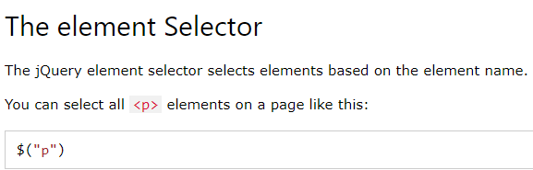
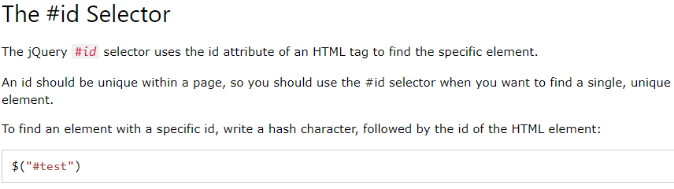

Slide 13
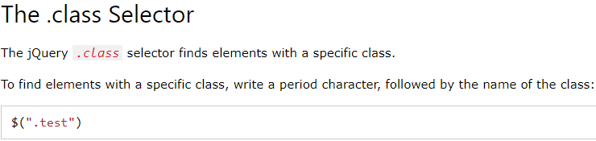
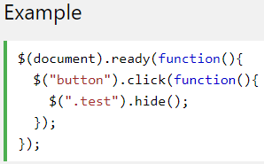

Slide 14
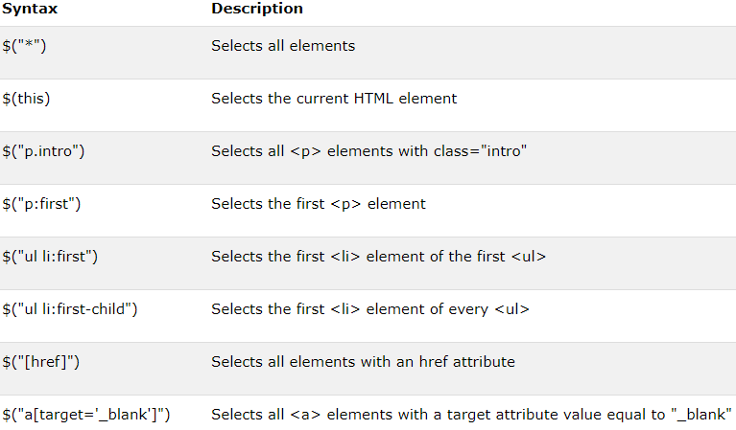

Slide 15
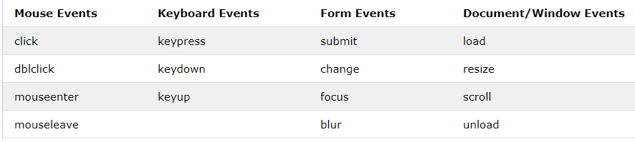
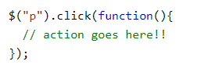
Events
In jQuery, most DOM events have an equivalent jQuery method. To assign a click event to all paragraphs on a page, you can do this:

Slide 16
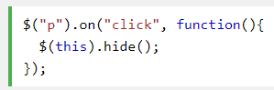
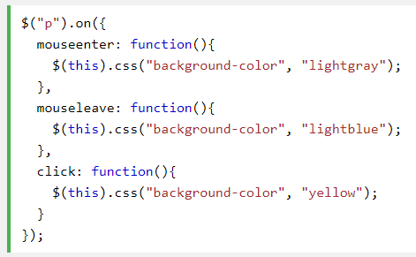
The on() method attaches one or more event handlers for the selected elements

Slide 17
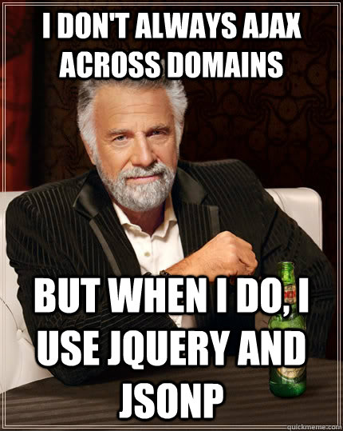
jQuery AJAX
AJAX is the art of exchanging data with a server, and update parts of a web page - without reloading the whole page.

Slide 18
$.ajax
This is the most basic method, only jQuery.ajax. All these parameters should be remembered:
async - asynchronous request, default true
cache - on / off browser data caching, default true
contentType - the default is "application / x-www-form-urlencoded"
data - transmitted data - string or object
dataType - the data type returned in the callback function (xml, html, script, json, text, _default)
jsonp - reinstall the name of the callback function to work with JSONP (by default it is generated on the fly)
type - GET or POST
url - url of the requested page

Slide 19
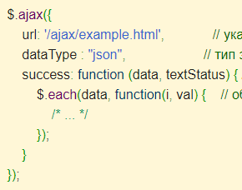
Local AJAX Events:
beforeSend - triggered before sending a request
error - if an error occurred
success - if there were no errors
completed - triggered at the end of the request

Slide 20
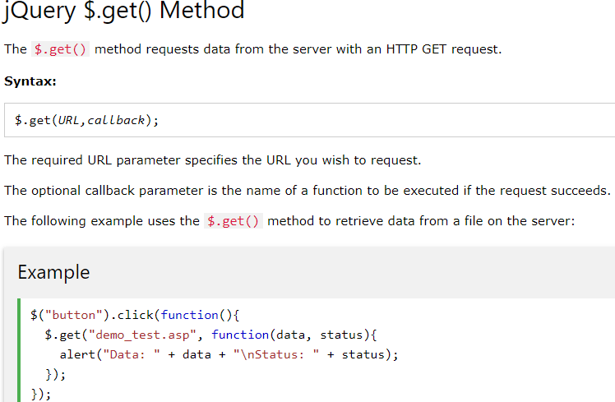

Slide 21
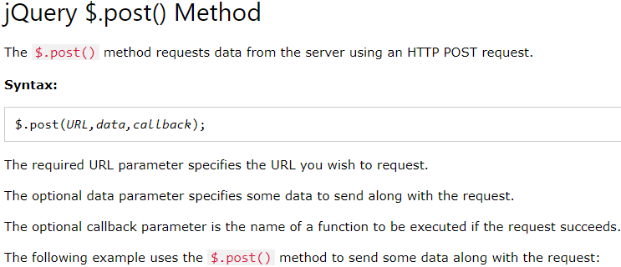

Slide 22
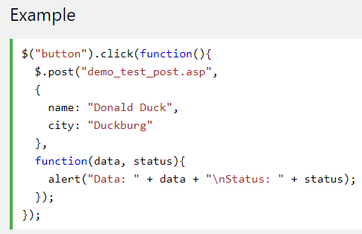

Slide 23
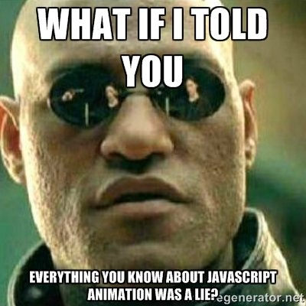
Velocity
Velocity is a cross-platform JavaScript library designed to simplify the client-side scripting of website animation.
Query is great, but it’s slow when you’re doing animations on your website. Enter Velocity.js: bypassing jQuery and directly using JavaScript animations (which are fast), Velocity offers superfast animations by synchronizing the DOM and the tween stack and caching values to minimize DOM queries. Also, it uses hardware acceleration.

Slide 24

What do these smart words mean???
Tween stack
tween.js
JavaScript tweening engine for easy animations, incorporating optimised Robert Penner's equations.
A tween (from in-between) is a concept that allows you to change the values of the properties of an object in a smooth way. You just tell it which properties you want to change, which final values should they have when the tween finishes running, and how long should this take, and the tweening engine will take care of finding the intermediate values from the starting to the ending point.

Slide 25
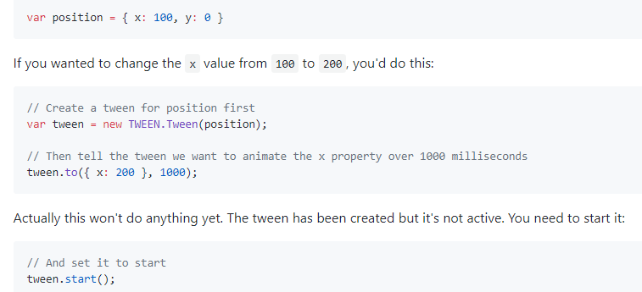
What do these smart words mean???
Tween stack Example

Slide 26
Animating with Velocity.js is, just like with jQuery, easy enough. Assuming there is an element with ID myelement on your page, you can fade it in over a period of 1.5 seconds by writing this:
Of course, we used jQuery here to get a hold of the element to animate, but you don’t have to. Velocity.js works just as well without jQuery (but bear in mind that this code only works when jQuery is not present, otherwise the Velocity function is not defined):

Slide 27
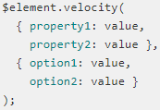
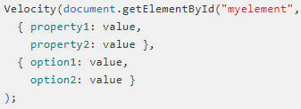
Velocity.js syntax
The common syntax used to do an animation with Velocity.js is this:
or, without jQuery:

Slide 28
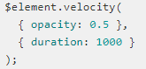
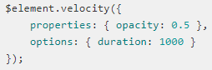
The call to Velocity.js has two arguments. The first argument is a group of properties that Velocity.js must animate, and the second argument is a group of options that influence how the animation should be done. Velocity.js comes with default values for all options, so you only have to specify option overrides. For example, to animate the opacity of an element, you would do:
Velocity.js also pass you to pass all arguments as a single object, if you prefer that:

Slide 29
There is also a shortcut for often-used options. You can pass in the effect duration, easing and completion function directly, without using an object (and this only applies to these properties). For instance, for a duration only:
Here’s one with easing and a completion callback as well:

Slide 30
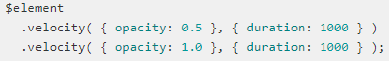
Velocity.js animation chaining
If you want to show multiple animations on an element, one after the other, you can chain them:
In this example, the element opacity will fade out to 50%, then back in again to 100%, and the second animation will not start before the first one is finished.

Slide 31
Velocity.js animation chaining
If you want to show multiple animations on an element, one after the other, you can chain them:
In this example, the element opacity will fade out to 50%, then back in again to 100%, and the second animation will not start before the first one is finished.

Slide 32
Looping animations with Velocity.js
If you want an animation to execute more than once, you can loop it. When you add a loop property, the animation will execute in and out for every count in the loop. For instance, this will have the element fade out and fade back in twice:
You can also set loop to true, which will cause infinite looping. If you want a pause between cycles, you can add the option delay: 100 (to wait 100ms between loops). When used without a loop, delay will cause the animation to pause for the specified time before it starts.

Slide 33
JavaScript Frameworks
Top 10 JavaScript
Frameworks: 1. Angular
2. React
3. Vue.js
4.Ember.js
5. Meteor
6. Mithril
7. Node.js
8. Polymer
9. Aurelia
10. Backbone.js
A software framework is an abstraction in which software providing generic functionality can be selectively changed by additional user-written code.
Frameworks are more adaptable for the designing of websites and hence, they are preferred by most of the website developers. JavaScript frameworks are a type of tool that makes working with JavaScript easier and smoother. These frameworks also make it possible for the programmer to code the application as device responsive. This responsiveness is yet another reason why the JavaScript frameworks are quite popular when it comes to the question of using a high-level machine language.

Slide 34
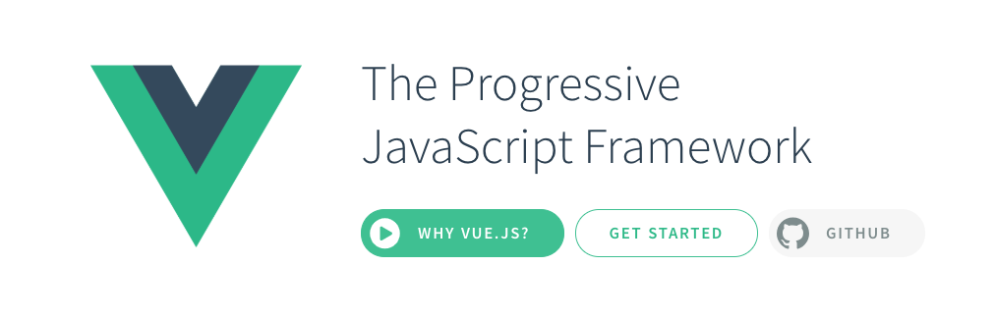
3. Vue.js
Though developed in the year of 2016, this JavaScript framework has already made its way into the market and has proven its worth. Its dual integration mode is one of the most attractive features for the creation of high-end SPA or Single Page Application. It is a much reliable platform for developing cross-platform.

Slide 35

2. React
Created by Facebook, React framework has earned popularity within a short period of time. In fact, it is used to develop and operate the dynamic User Interface of the web pages with high incoming traffic. It makes the use of a virtual DOM and hence, the integration of the same with any application is easier.

Slide 36
What do these smart words mean???
Virtual DOM
The main problem of DOM is that it was never designed to create a dynamic user interface (UI). We can work with it using JavaScript and libraries like jQuery, but using them does not solve performance problems.
Look at modern social networks like Twitter, Facebook or Pinterest.
After a little scrolling, we will have tens of thousands of DOM nodes, and interacting with them effectively is not an easy task

Slide 37
What do these smart words mean???
For example, try moving 1000 divs 5 pixels left.
It may take more than a second - this is too much for the modern Internet. You can optimize the script and use some tricks, but in the end it will only cause a headache when working with huge pages and dynamic UI.
Instead of interacting with the DOM directly, we work with its lightweight copy. We can make changes to the copy based on our needs, and then apply the changes to the real DOM. When this happens, a DOM tree is compared with its virtual copy, the difference is determined and a redrawing of what has been changed is launched.
This approach works faster, because it does not include all the heavyweight parts of the real DOM.

Slide 38
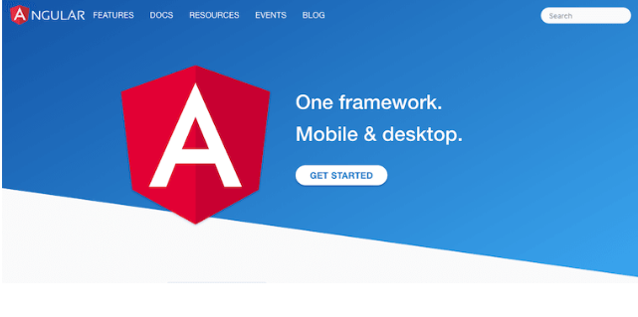
1. Angular
Winner
One of the most powerful, efficient, and open-source JavaScript frameworks is Angular. This framework is operated by the Google and is basically implemented to use for developing Single Page Application (SPA). It extends the HTML into the application and interprets the attributes in order to perform data binding.

Slide 39

Thank you for your attention! <З
Too little information for you?
Here are the sources:
JavaScript: https://www.w3schools.com/js/default.asp
jQuery: https://www.w3schools.com/jquery/default.asp
Velocity: http://www.independent-software.com/velocity-js-tutorial-accelerated-javascript-animation.html
Frameworks overview: https://hackr.io/blog/10-best-javascript-frameworks-2019
Winner
Other stuff: https://github.com/sole/tween.js/blob/master/docs/user_guide.md
https://habr.com/ru/post/256965/
https://habr.com/ru/post/42426/

